Slide 2
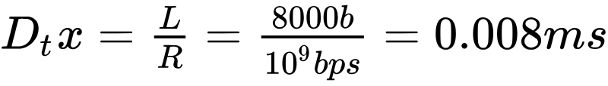
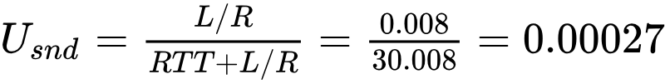

Performance of rdt3.0
rdt3.0 correct, but performance stinks
Calculate:
Transmission delay of 8000bit packet on 1Gbps link
Link utilization, or the fraction of time sender is transmitting, assuming 15ms propagation delay and negligible size ACK packets
Link goodput, or rate of data delivery over time
On a 1Gbps link!
Notes:
NOTE: merge this into the following slide next year

Slide 3
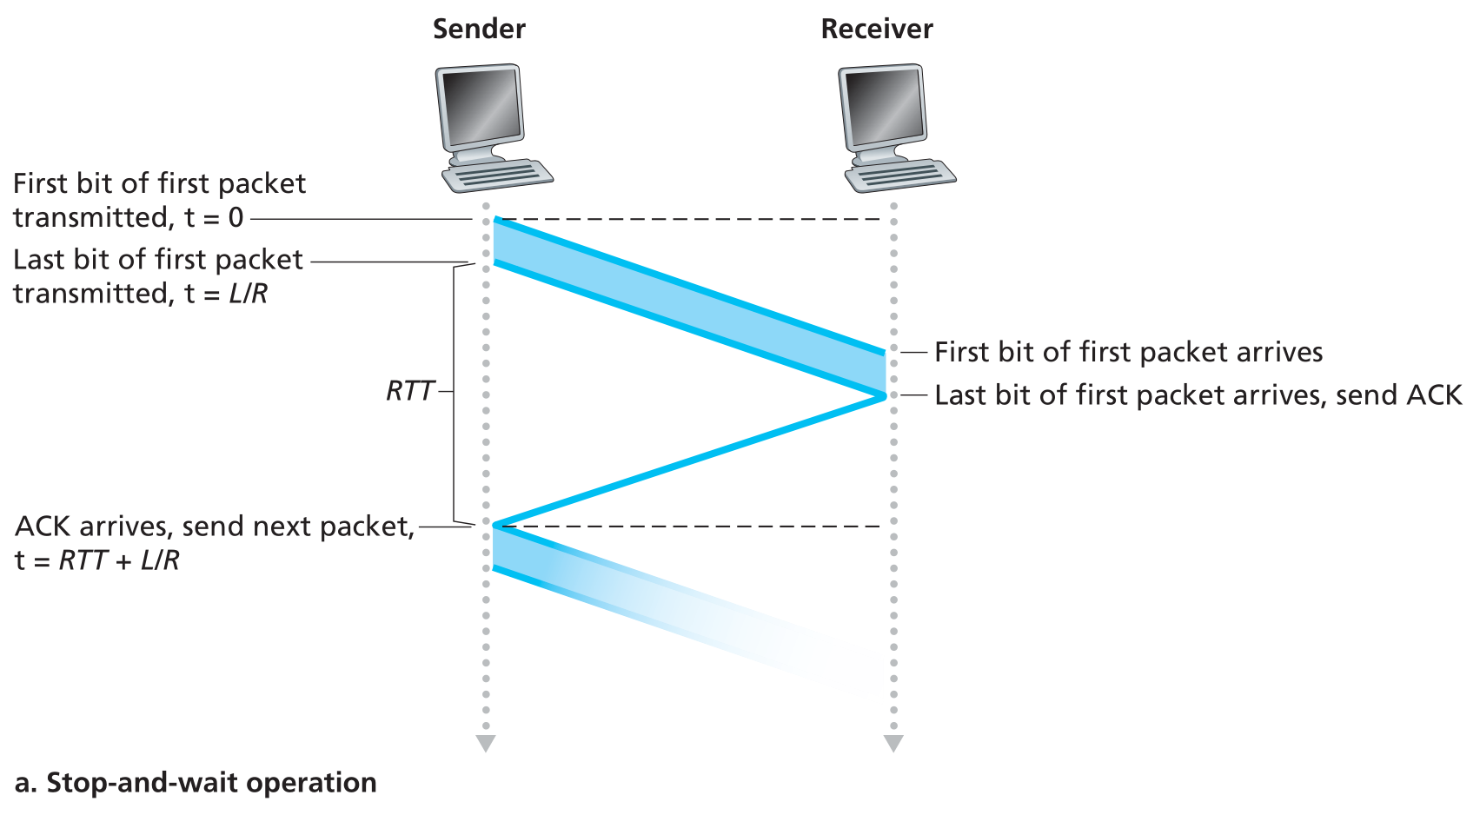
rdt3.0: stop-and-wait operation

Slide 4
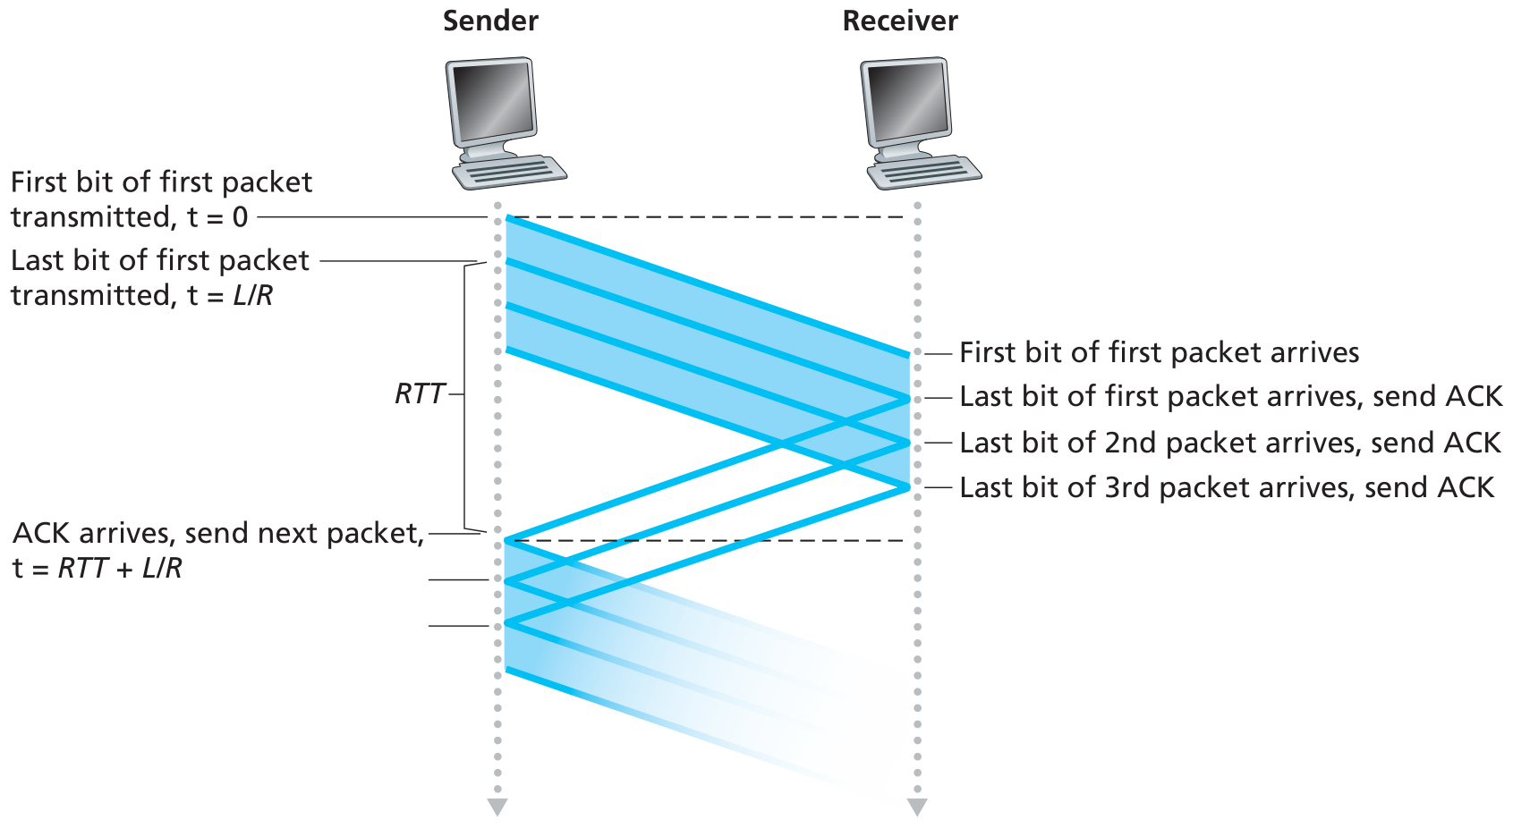
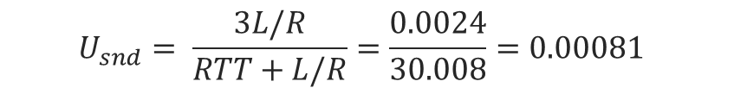
Pipelining: increased utilization
Pipelining: Sender allows multiple, “in-flight”, yet-to-be-acknowledged packets
Range of sequence numbers must be increased
Buffering at sender and/or receiver
3-packet pipelining increases
utilization by a factor of 3!

Slide 5
Pipelined protocols: Overview
Go-back-N (GBN)
Selective Repeat (SR)
Sender can have up to N unacked packets in pipeline
Receiver only sends cumulative ack
ACK for last contiguous packet
No ACK for new packets past a sequence number gap
Sender has timer for oldest unacked packet
When timer expires, retransmit all unacked packets
Sender can have up to N unacked packets in pipeline
Receiver sends individual ACK for each packet
Sender maintains timer for each unacked packet
When timer expires, retransmit only that unacked packet
What are the relative advantages of each protocol?

Slide 6
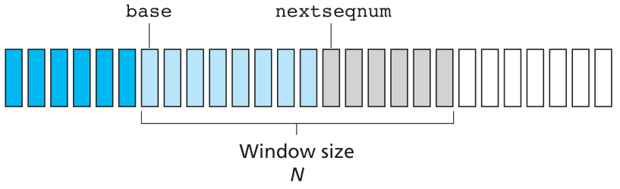
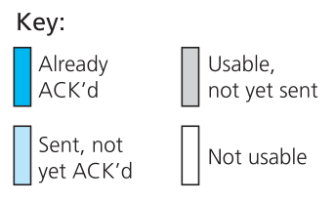
GBN: Sender window
“Window” of up to N, consecutive unacknowledged packets allowed

Slide 7

GBN in action
sender window (N=4)
sender
receiver
0 1 2 3 4 5 6 7 8
send pkt0
send pkt1
send pkt2
send pkt3
(wait)
0 1 2 3 4 5 6 7 8
receive pkt0, send ack0
receive pkt1, send ack1
receive pkt3, discard,
(re)send ack1
0 1 2 3 4 5 6 7 8
X
0 1 2 3 4 5 6 7 8
loss
0 1 2 3 4 5 6 7 8
rcv ack0, send pkt4
rcv ack1, send pkt5
0 1 2 3 4 5 6 7 8
receive pkt4, discard,
(re)send ack1
ignore duplicate ACK
receive pkt5, discard,
(re)send ack1
pkt 2 timeout
0 1 2 3 4 5 6 7 8
send pkt2
send pkt3
send pkt4
send pkt5
0 1 2 3 4 5 6 7 8
0 1 2 3 4 5 6 7 8
rcv pkt2, deliver, send ack2
rcv pkt3, deliver, send ack3
rcv pkt4, deliver, send ack4
rcv pkt5, deliver, send ack5
0 1 2 3 4 5 6 7 8

Slide 8
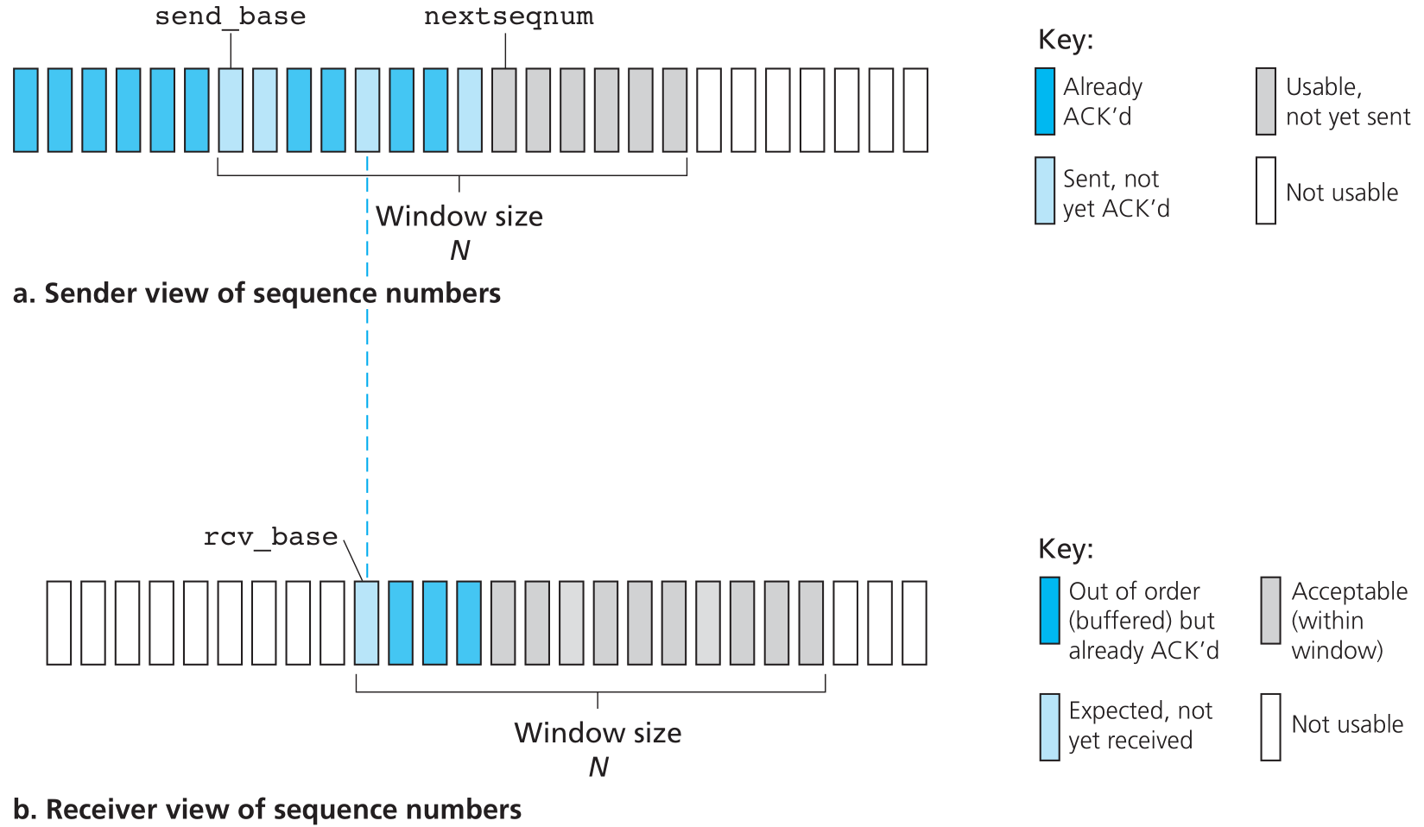
Selective Repeat (SR)
Sender only resends pkts for which ACK not received
Receiver individually ACKs all correctly received pkts
Notes:
Work out the transmission diagram
Why are the sender and receiver windows not in allignment?

Slide 9

SR in action
sender window (N=4)
sender
receiver
0 1 2 3 4 5 6 7 8
send pkt0
send pkt1
send pkt2
send pkt3
(wait)
0 1 2 3 4 5 6 7 8
receive pkt0, send ack0
receive pkt1, send ack1
receive pkt3, buffer,
send ack3
0 1 2 3 4 5 6 7 8
X
loss
0 1 2 3 4 5 6 7 8
0 1 2 3 4 5 6 7 8
rcv ack0, send pkt4
rcv ack1, send pkt5
0 1 2 3 4 5 6 7 8
receive pkt4, buffer,
send ack4
record ack3 arrived
receive pkt5, buffer,
send ack5
pkt 2 timeout
0 1 2 3 4 5 6 7 8
send pkt2
0 1 2 3 4 5 6 7 8
record ack4 arrived
0 1 2 3 4 5 6 7 8
rcv pkt2; deliver pkt2,
pkt3, pkt4, pkt5; send ack2
record ack4 arrived
0 1 2 3 4 5 6 7 8
Notes:
Q: what happens to the window when ack2 arrives?

Slide 10
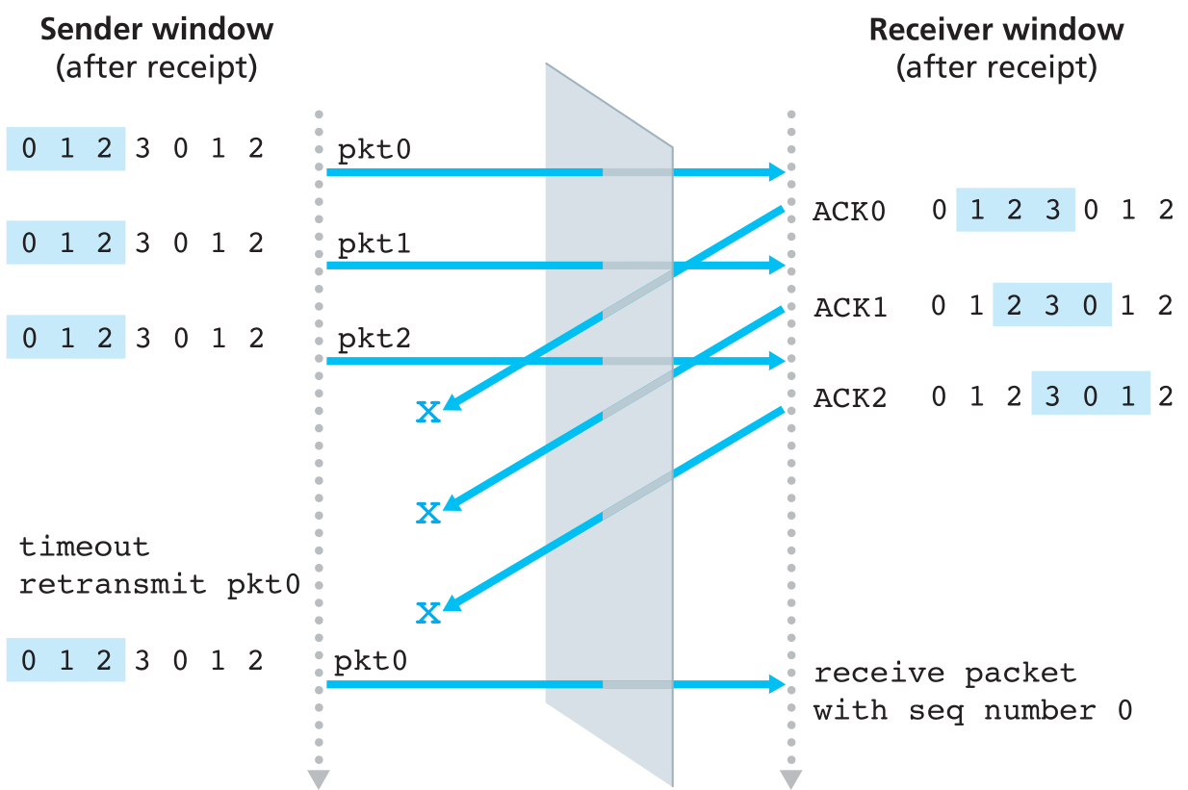
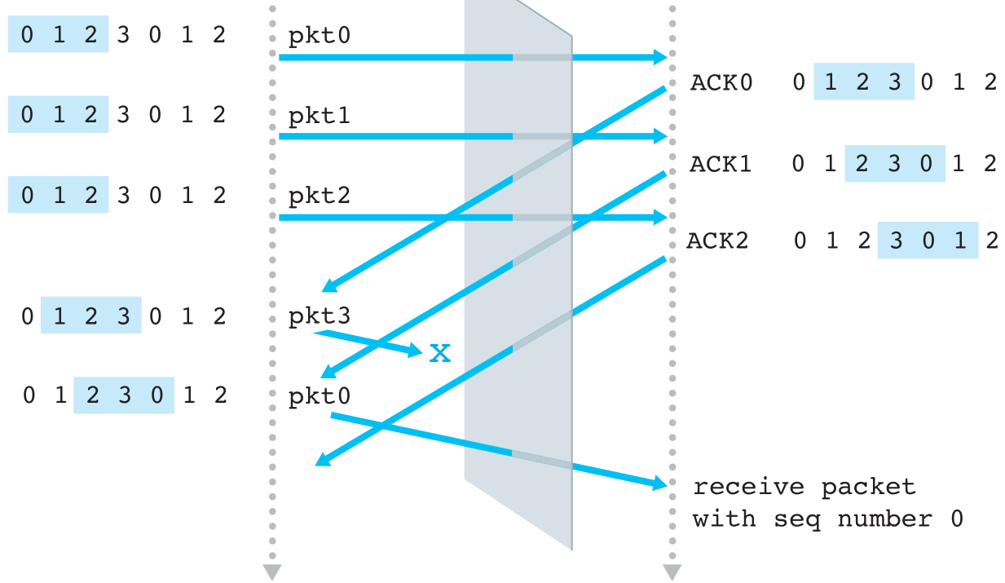
Selective Repeat Dilemma
Receiver sees no difference in the two scenarios!
Duplicate data accepted as new in the second scenario!
Q: What should be the relationship between window size and sequence numbers to avoid the problem?

Slide 11
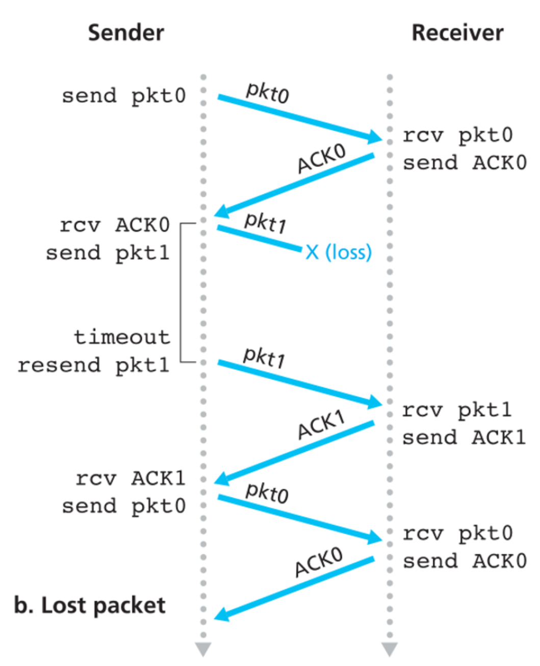
TCP round trip time, timeout
Q: How to set TCP timeout value?
Too short: premature timeout, unnecessary retransmissions
Too long: slow reaction to segment loss
Longer than RTT?
but RTT varies

Slide 12
TCP round trip time, timeout
Q: how to estimate RTT?
SampleRTT: measured time from segment transmission until ACK receipt
SampleRTT will vary, want estimated RTT “smoother”
Average several recent measurements, not just current SampleRTT

Slide 13
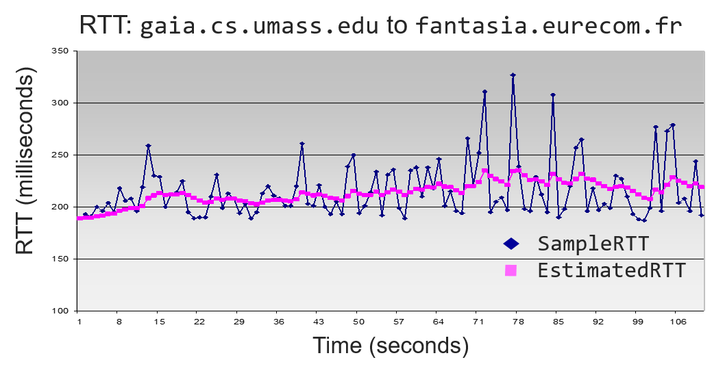
TCP round trip time, timeout
Exponential weighted moving average
EstimatedRTT = (1-α)*EstimatedRTT + α*SampleRTT
Typical value: α=0.125
TimeoutInterval
=
EstimatedRTT ?
Notes:
- Bad idea – will timeout half the time!

Slide 14

TCP round trip time, timeout
Timeout interval:
EstimatedRTT plus “safety margin”
large variation in EstimatedRTT → larger safety margin
Estimate SampleRTT deviation from EstimatedRTT:
DevRTT = (1-β)*DevRTT +
β*|SampleRTT-EstimatedRTT|
TimeoutInterval = EstimatedRTT + 4*DevRTT
Estimated RTT
“safety margin”

Slide 15
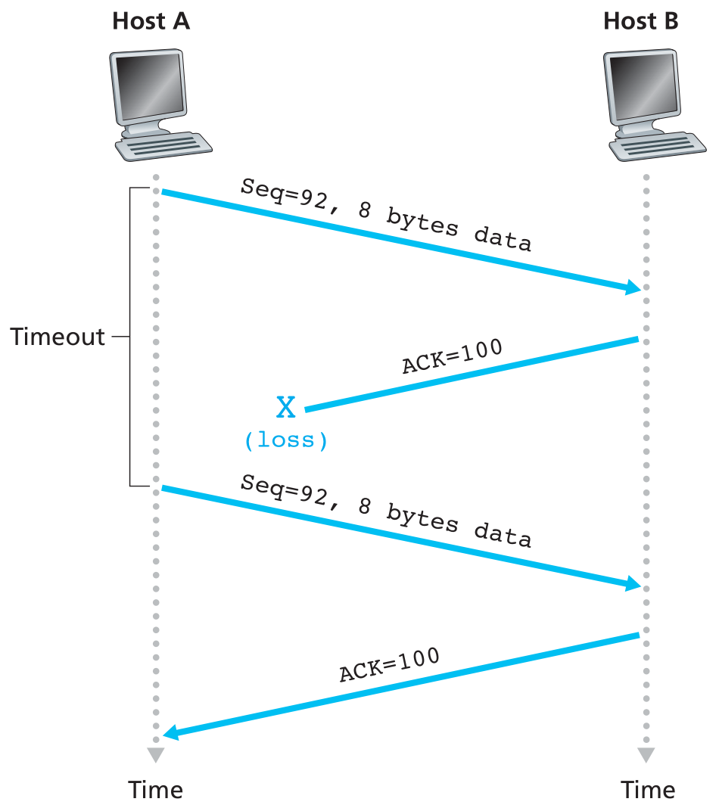
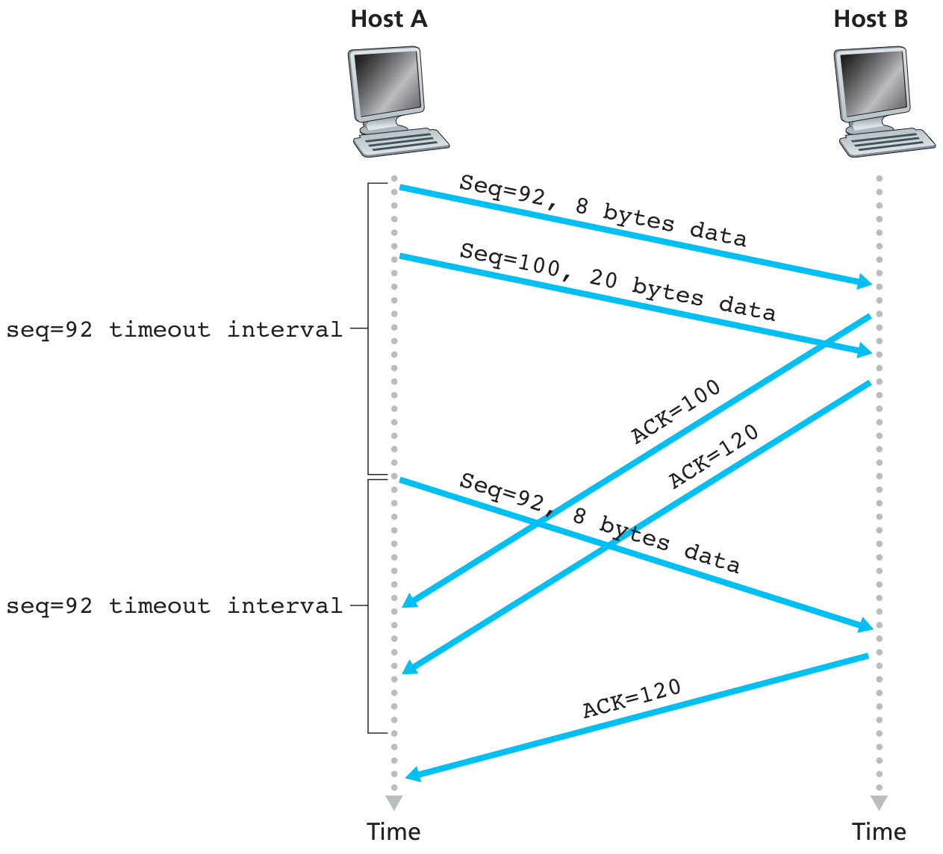
TCP retransmission scenarios
Lost ACK scenario
Premature timeout

Slide 16
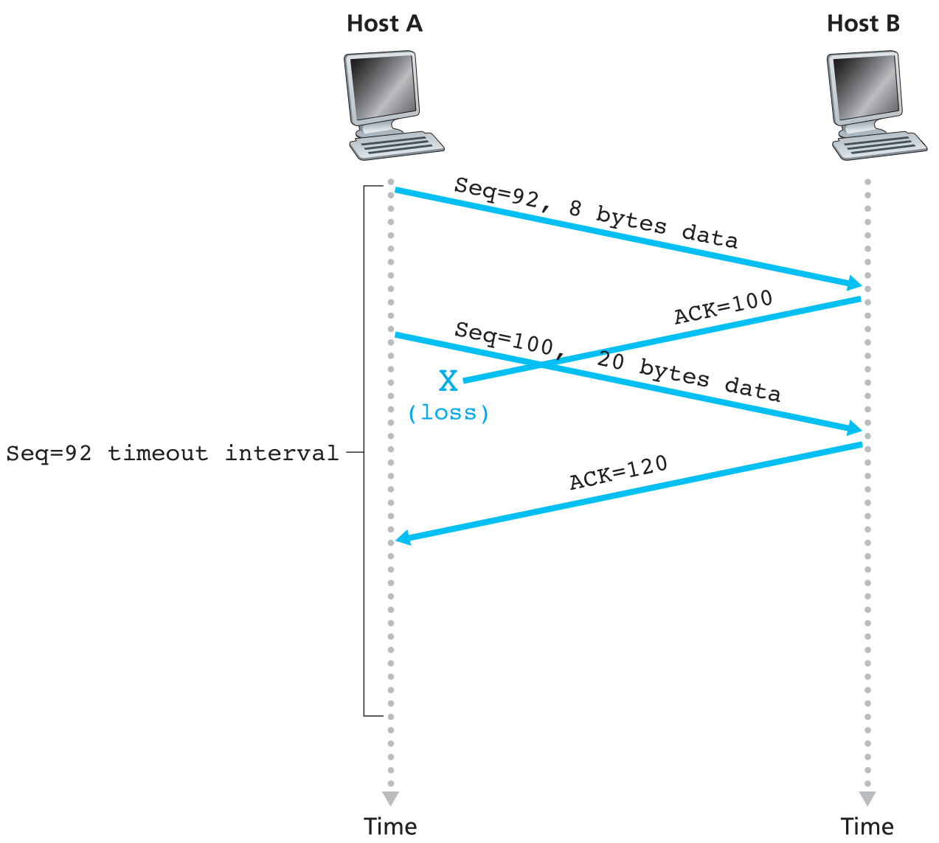
TCP: retransmission scenarios
Cumulative ACK

Slide 17
TCP ACK generation
Event at receiver
arrival of in-order segment with
expected seq #. All data up to
expected seq # already ACKed
arrival of in-order segment with
expected seq #. One other
segment has ACK pending
arrival of out-of-order segment
higher-than-expect seq. # .
Gap detected
arrival of segment that
partially or completely fills gap
TCP receiver action
delayed ACK. Wait up to 500ms
for next segment. If no next segment,
send ACK
immediately send single cumulative
ACK, ACKing both in-order segments
immediately send duplicate ACK,
indicating seq. # of next expected byte
immediate send ACK, provided that
segment starts at lower end of gap

Slide 18

TCP fast retransmit
Host A
Host B
Time-out period often relatively long before packet loss detected
Detect lost segments via duplicate ACKs
Many packets in pipeline
If segment lost, many duplicate ACKs generated
TCP fast retransmit
Resend packet after 3 duplicate ACKs
Do not wait for timeout – packet probably already lost
Seq=92, 8 bytes of data
Seq=100, 20 bytes of data
X
timeout
ACK=100
ACK=100
ACK=100
ACK=100
Seq=100, 20 bytes of data
Fast retransmit after sender
receipt of triple duplicate ACK
Notes:
Why three duplicate acks

